Slide 1
Faculty Assembly Annual Meeting
September 17, 2025
Welcome faculty, colleagues and friends of CMSRU & CUHC

Slide 2
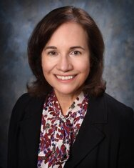
State of the Medical School
Annette C. Reboli, M.D. Dean
Professor of Medicine
Tenured Professor of
Biomedical Sciences

Slide 3
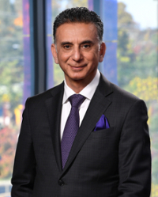
“University of the Future” Dr. Ali Houshmand President, Rowan University

Slide 4


Slide 5

Top 100 public research university
24,500+ students
3 medical schools
$1.3B in university related construction in the past decade
$1.5B planned in the next decade

Slide 6
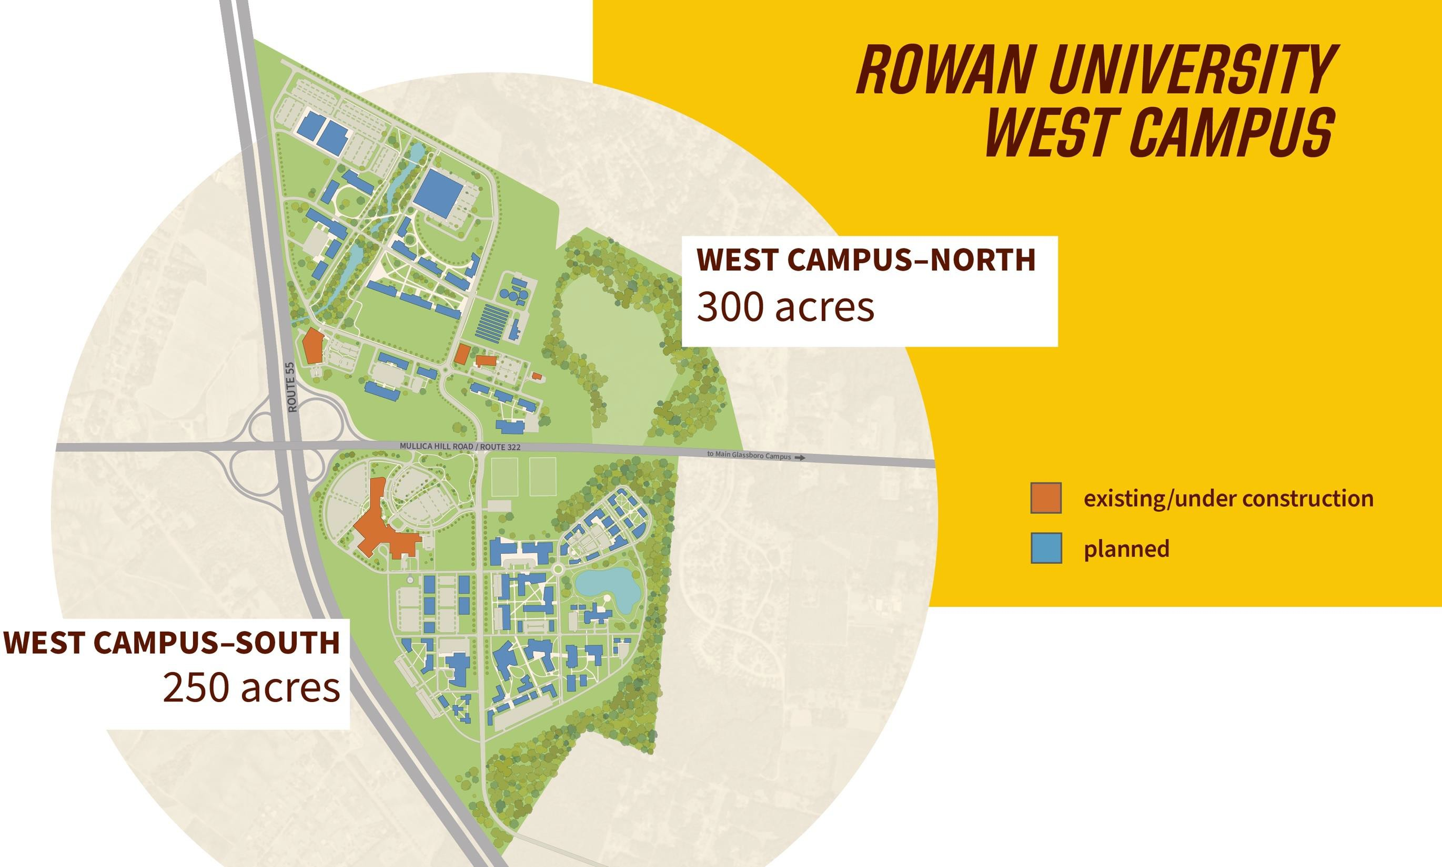

Slide 7
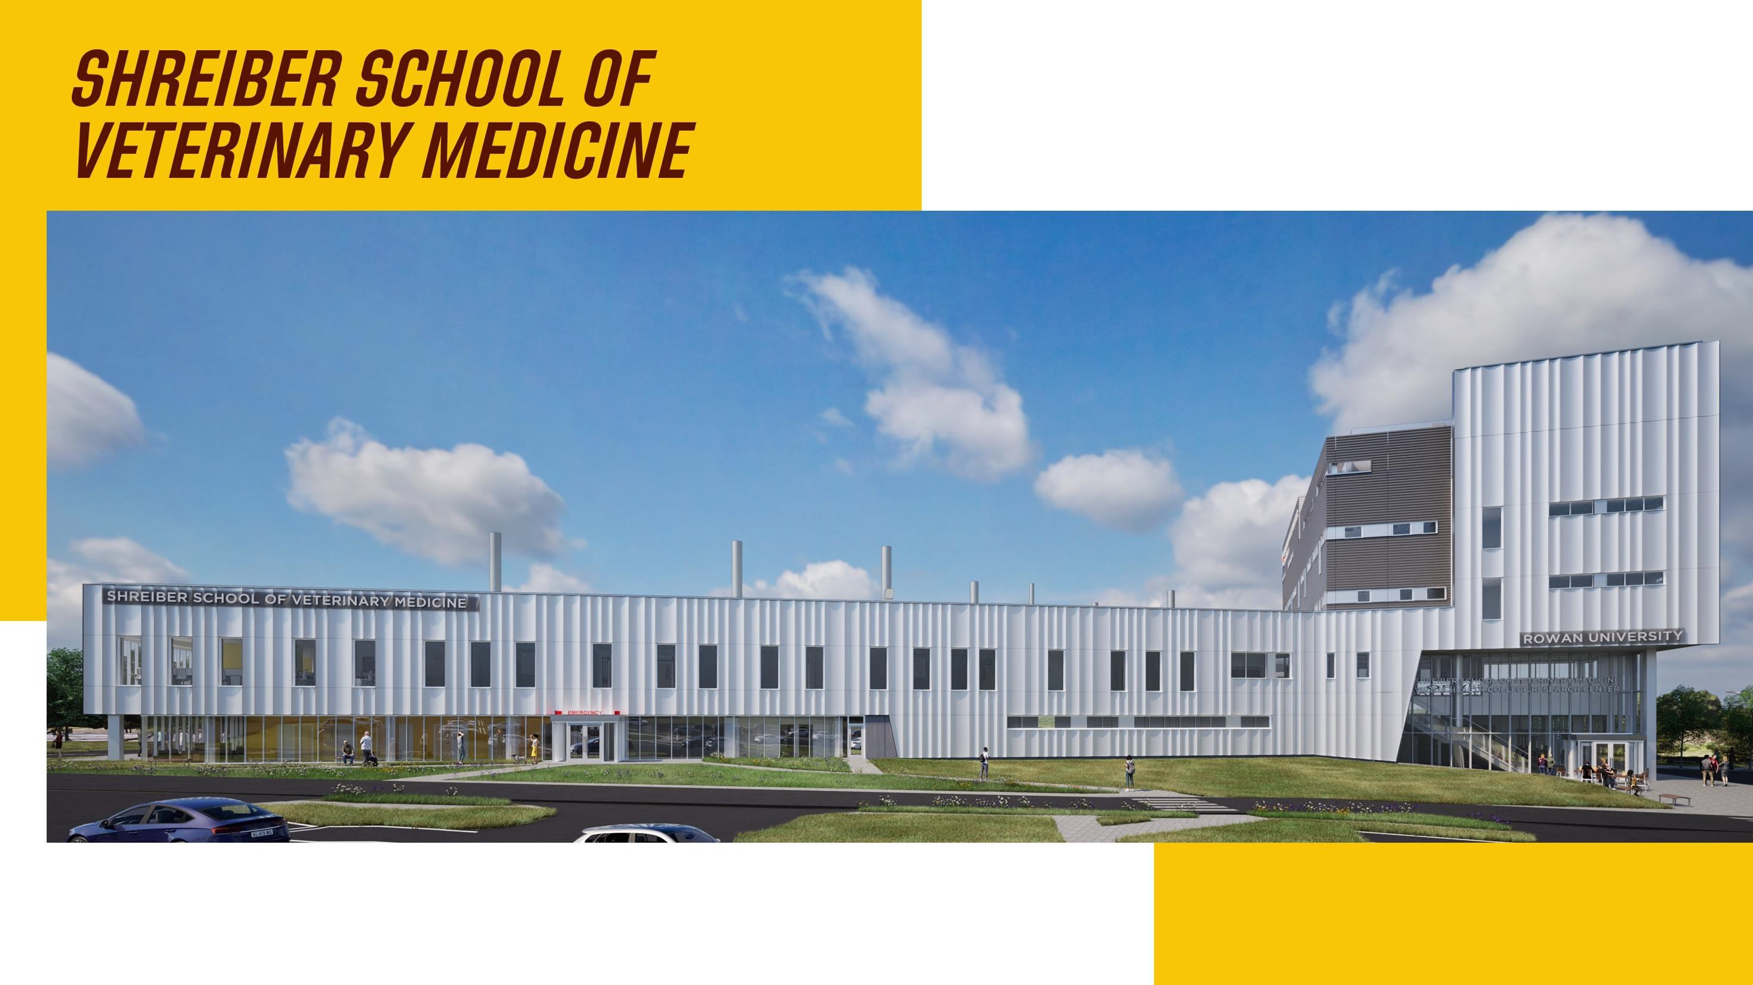
completion Fall 2025
UNDER CONSTRUCTION
117,000 sq. ft.
$140M
Educational & training facilities Veterinary teaching hospital

Slide 8

completion 2026
UNDER CONSTRUCTION
50,000 sq. ft.
$60M

Slide 9
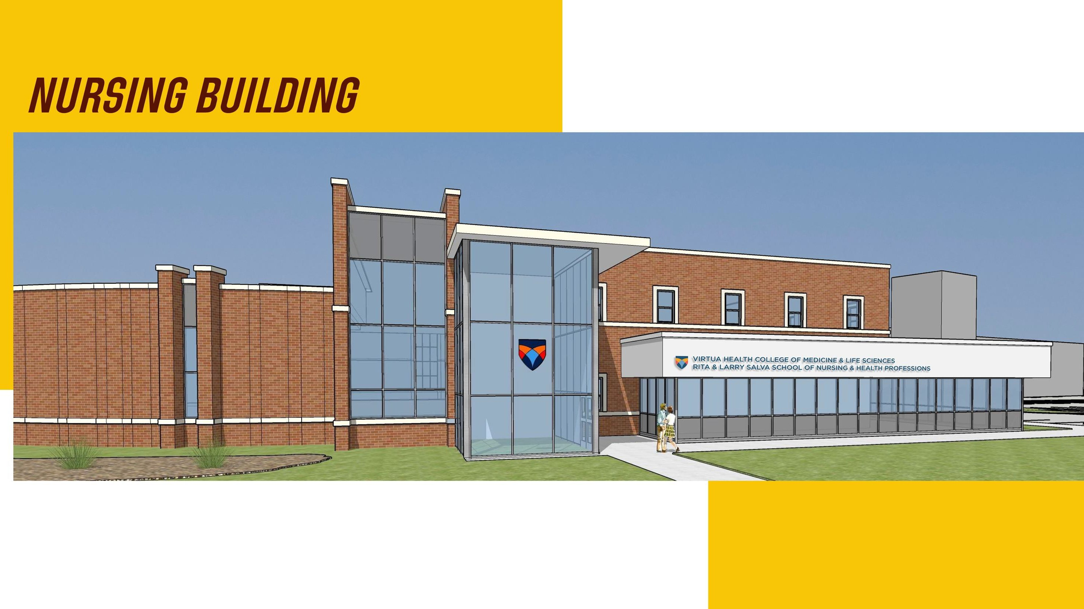
Completion Fall 2026
UNDER CONSTRUCTION
40,000 sq. ft.
$29M

Slide 10
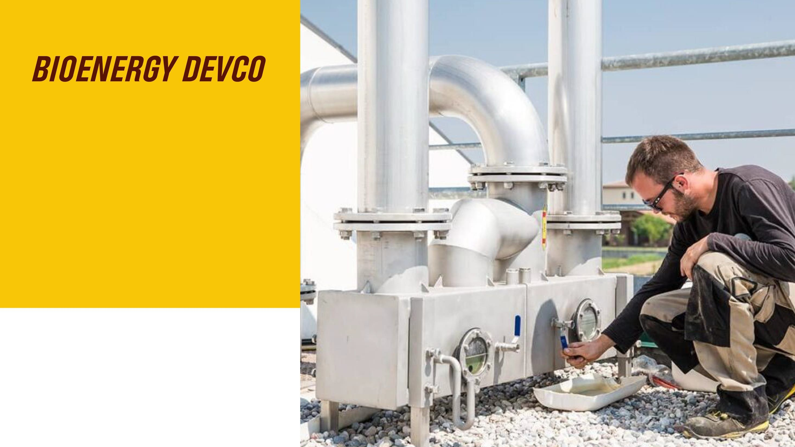
Private company facility
10 acres, $30M estimated cost
Converts biomass to methane
Will generate 3.5MW to
5MW of energy
West Campus—North

Slide 11
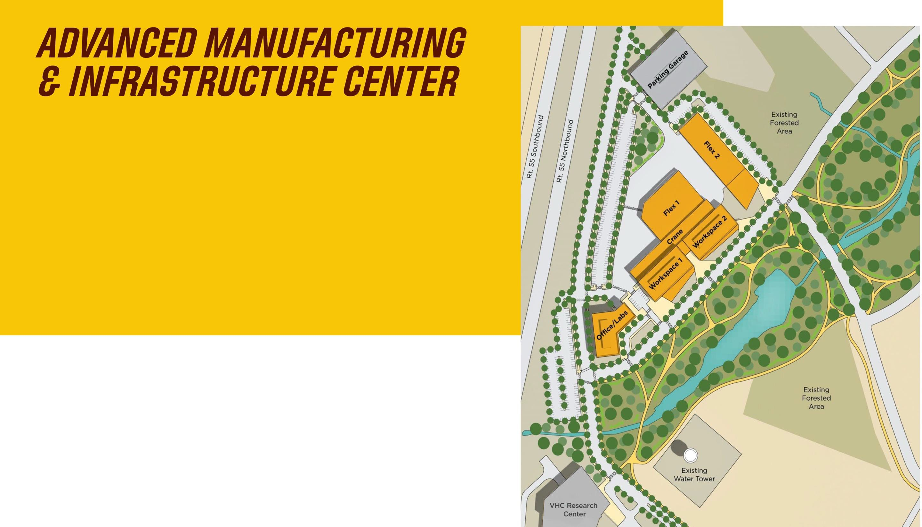
Public-private development
100,000-165,000 sq. ft.
Space available for lease
Anticipated completion 2028
West Campus—North

Slide 12
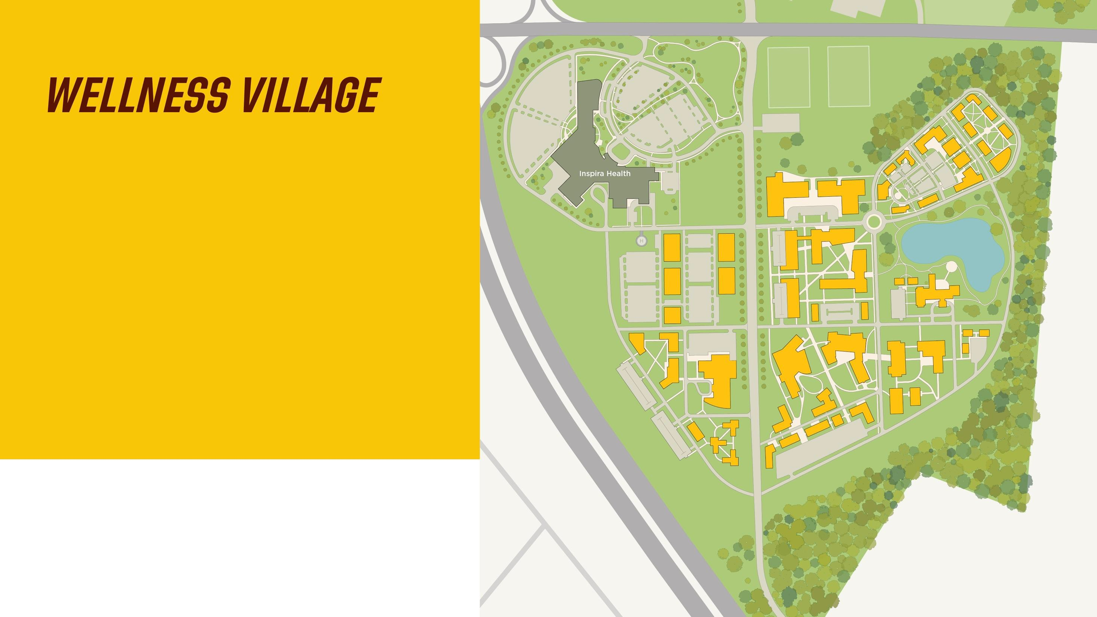
Public-private development
210 acres
Intergenerational housing, retail, medical and commercial office space surrounded by biking and walking trails.
West Campus—South

Slide 13

University affiliated project of past decade:
Projects in progress:
$1.5B
$1.7B
FEATURED PROJECTS IN DEVELOPMENT | SQ FT. | ESTIMATED COST
Campbell Library Renovation | 140,000 | $25 million
Ric Edelman College of Communication, Humanities & Social Sciences Building | 50,000 | $80 million
Physician Assistant Education Facility–Sewell | 10,000 | $10 million
Esbjornson Gymnasium Renovation | 20,000 | $6 million
CMSRU Research Lab | 6,000 | $5 million
Holistic Wellness Village | TBD | $1 billion

Slide 14


Slide 15
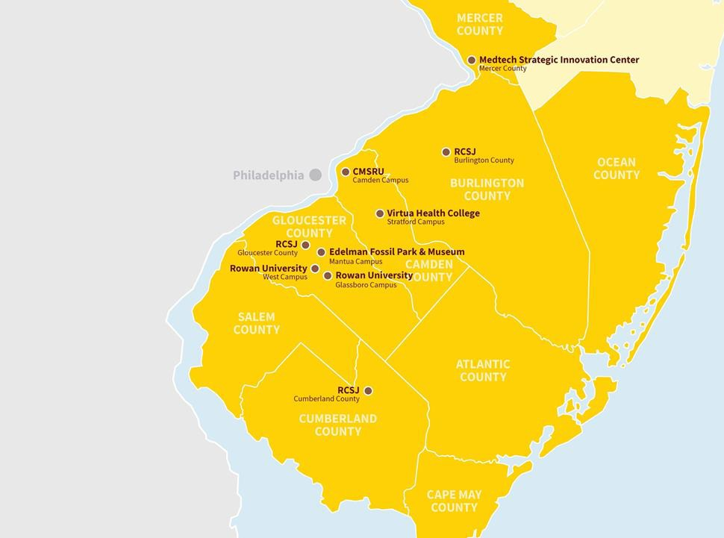

Third fastest-growing research university in the United States with a $2.9B annual economic impact in New Jersey.
Research strengths in life sciences, advanced manufacturing, AI and transportation infrastructure.
West Campus home to more than $70M in Department of Defense contracts in
manufacturing, advanced materials and AI.
New growth with new life sciences research building opening in Fall 2025 and Digital Manufacturing Hub in design.

Slide 16

Just 9 households hold 15% of the region’s wealth.
A mere .1% of residents hold 71% of the tech hub’s wealth.
Cost of living has risen. Renters must earn $136,532 to afford
an apartment.

Slide 17
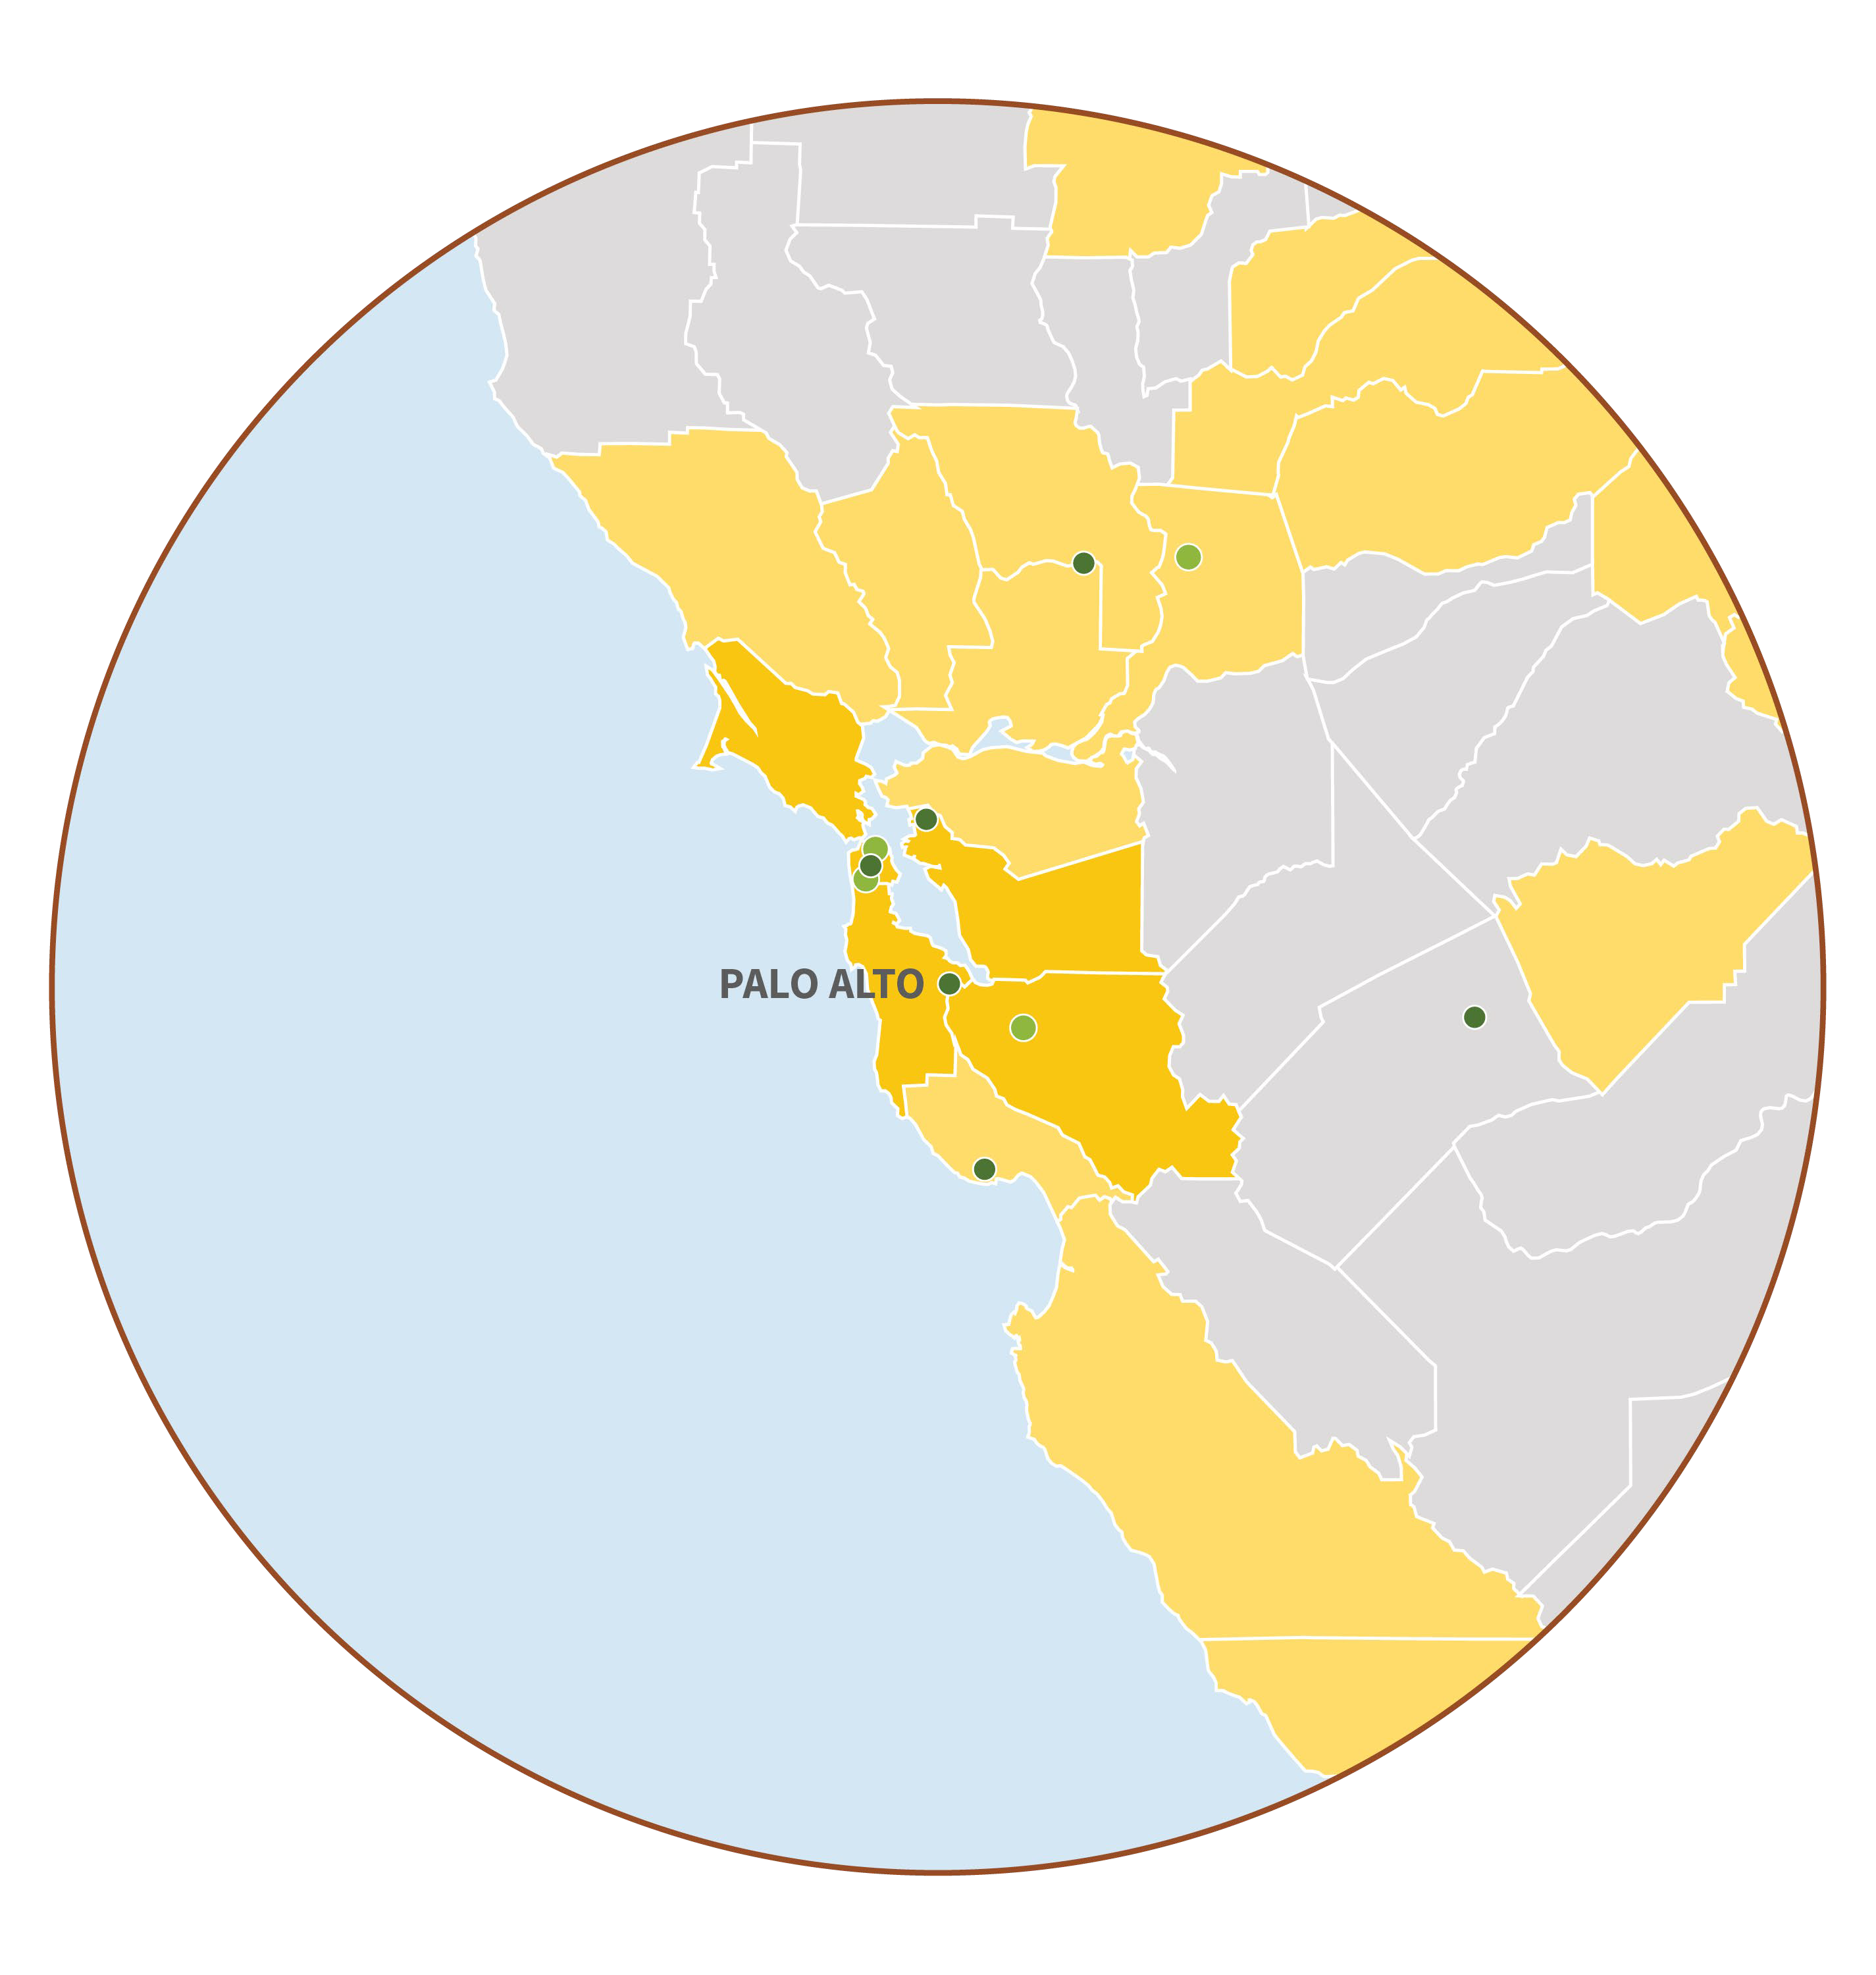


Silicon Valley | Palo Alto
Santa Clara County Population: 1,926,325 (2024 est.) Median Home Price: $1,588,730 Mean Rental Price: $3,572 Median Income: $154,954
Palo Alto
Population: 68,572 (2024 est.) Median Home Price: $3,500,000 Mean Rental Price: $4,548 Median Income: $184,068
Within 150-mile radius of Palo Alto Population: 14,431,899 (2024 est.)
Percentage of 25+ year-olds with BA or BS degree
< 25%
25%-50%
50%-75%
> 75%
Carnegie Classification for Institutions of Higher Education
R1 Universities R2 Universities
Population: Annual Estimates of Resident Population, U.S. Census Bureau (March 2025), Median Home Price: National Association of Realtors, Mean rent: Zillow Observed Rent Index (July 2025), Median income: Median Household Income by County, Census.gov (September 2024)
California
150-mile radius

Slide 18
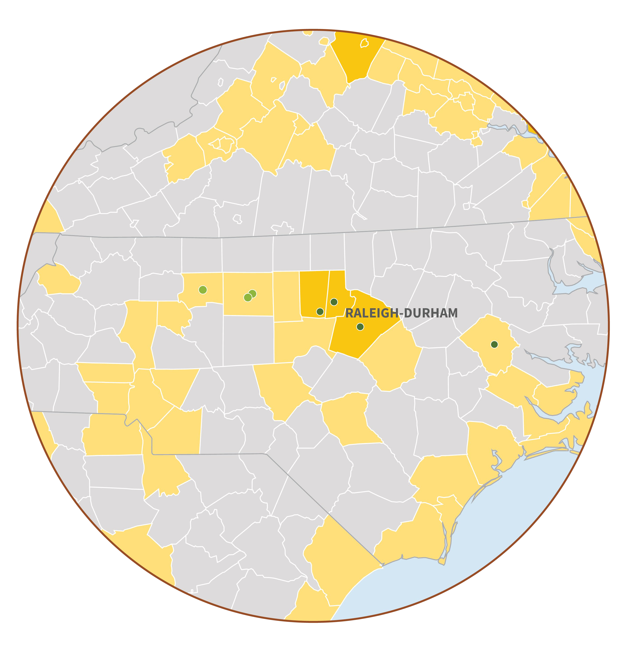

Research Triangle | Raleigh-Durham-Chapel Hill
Wake, Durham & Orange Counties Population: 1,640,100 (2024 est.) Median Home Price: $492,070 Mean Rental Price: $1,759
Median Income: $92,231
Within 150-mile radius of Raleigh Population: 13,218,628 (2024 est.)
Percentage of 25+ year-olds with BA or BS degree
< 25%
25%-50%
50%-75%
> 75%
Carnegie Classification for Institutions of Higher Education
R1 Universities R2 Universities
Population: Annual Estimates of Resident Population, U.S. Census Bureau (March 2025), Median Home Price: National Association of Realtors Mean rent: Zillow Observed Rent Index (July 2025), Median income: Median Household Income by County, Census.gov (September 2024)
North Carolina and region
150-mile radius

Slide 19
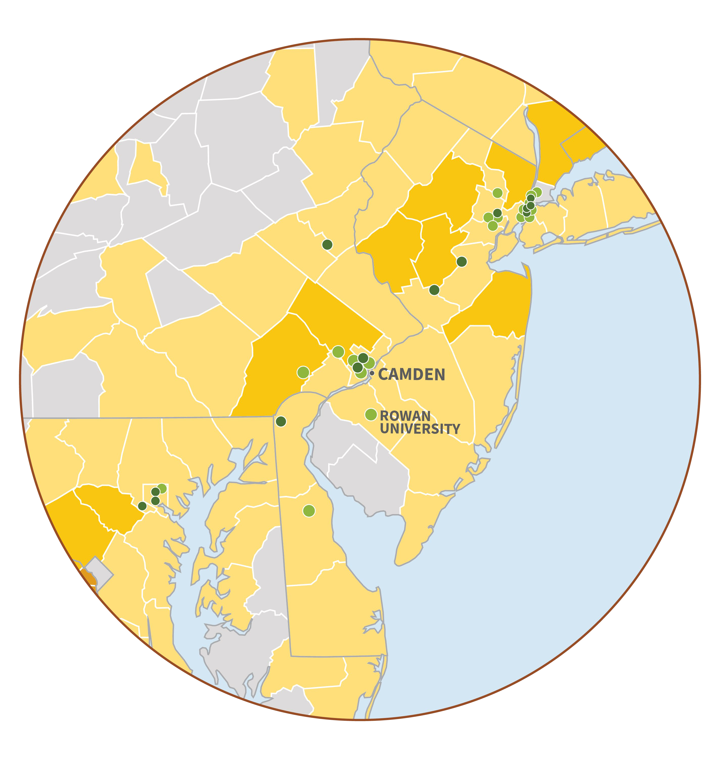

South Jersey
Eight-county region Population: 2,582,261 (2024 est.) Median Home Price: $419,115 Mean Rental Price: $2,150 Median Income: $85,356
New Jersey K-12 Excellence: #1 in nation
Within 150-mile radius of Camden City Population: 41,139,187 (2024 est.)
Percentage of 25+ year-olds with BA or BS degree
< 25%
25%-50%
50%-75%
> 75%
Carnegie Classification for Institutions of Higher Education
R1 Universities R2 Universities
Population: Annual Estimates of Resident Population, U.S. Census Bureau (March 2025), Median Home Price: National Association of Realtors, Mean rent: Zillow Observed Rent Index (July 2025), Median income: Kelley School of Business, Indiana Business Research Center
New Jersey and region
150-mile radius

Slide 20
Faculty Assembly Update
Roland Schwarting, M.D.
Outgoing Faculty Assembly President
Professor of Pathology

Slide 21
Faculty Assembly Executive Members
Outgoing President: Roland Schwarting, MD, Professor of Pathology
Incoming President: Manoj Pandey, PhD, Associate Professor of Biomedical Sciences
Vice President: Ritesh Patel, MD, Associate Professor of Clinical Medicine
Secretary: Eric Behling, MD, Associate Professor of Clinical Pathology
Officers: Kevin Currie, PhD, Professor of Biomedical Sciences
Joanne Mazzarelli, MD, Associate Professor of Clinical Medicine
Staff: Anne Peatman, MBA, Assistant Dean for Faculty Affairs

Slide 22
Admissions Committee
Gary E. Stahl, MD, Committee Chair
2024-2025 Highlights of Committee Work
Selection Class of 2029 students
(4619 applications received)
18 committee meetings & 16 interview days
(369 candidates interviewed)
2 open houses for accepted students (Dec & Mar)
CMSRU Class of 2029 metrics:
Class size – 118
71% of accepted students from NJ
Average overall GPA – 3.86
Average science GPA – 3.82
Average MCAT – 513 (87%ile)
The committee selected 11 high school students to participate in the 3+4 BS/MD program with Rowan University.

Slide 23
Research Committee Christopher Jones, MD, Committee Chair
2024-2025 Highlights of Committee Work
Actively engaged in addressing institutional growth, research infrastructure, and faculty development.
Management & expansion of laboratory space for basic biomedical research and policies information availability of space for use by biomedical science faculty.
Strategies for ensuring high-quality opportunities for medical students to participate in both basic science and clinical research including improving the number and quality of Capstone Mentors and strategies for M1 summer biomedical research program sustainable given funding challenges.
Efforts to standardize use of author affiliations among basic science and clinical faculty members and promote ORCID adoption among faculty.
2025-2026 Future Goals and Plans
Expand institutional infrastructure available in support both basic biomedical research and clinical research at CMSRU.
Remain focused on expanding opportunities for medical students to engage in meaningful research activities.
Capstone Speed Dating Event: Tuesday, Sept. 30th - 5:30 pm (CMSRU MPR)
Continue efforts to standardize author affiliations and ORCID adoption.

Slide 24









CMSRU Active External Grant Awards – BMS Faculty
*
External Grant Submissions
External New Awards (Total Funding)
*2025=To date; Also note freeze/reduction in NIH funding
Exponential Growth In Both Submissions And Funding Since 2016

Slide 25
CMSRU Active External Grant Awards
INVESTIGATOR | AGENCY | TOTAL FUNDING
Amanda Fakira | National Institutes of Health (NIH) R01 | $2,322,527.00
Amanda Fakira | Alexandrine and Alexander L. Sinsheimer Foundation | $300,000.00
Annette Reboli | Health Resources and Services Administration (HRSA) | $500,000.00
Annette Reboli | Health Resources and Services Administration (HRSA) | $1,992,155.00
Annette Reboli | Health Resources and Services Administration (HRSA) | $2,600,000.00
Ben Sorum | National Institutes of Health (NIH) R00 | $724,590.00
Brandi Sweet | New Jersey Commission on Cancer Research | $100,000.00
Diana Martinez | National Institutes of Health (NIH) LRP | $100,000.00
Diana Martinez | National Institutes of Health (NIH) R16 | $681,480.00
Diana Martinez | American Heart Association (AHA) CDA | $230,091.00
Diana Martinez (MPI) | National Institues of Health (NIH) R21 | $423,708.00
Emily Hansen | New Jersey Commission on Cancer Research | $100,000.00
James Holaska | National Institutes of Health (NIH) R15 | $475,680.00
Jocelyn Mitchell-Williams | The New Jersey Office of the Secretary of Higher Education (OSHE) | $49,524.00
Kaitlan Baston | NJ Department of Human Services | $2,781,247.34
Kevin Currie | National Institutes of Health (NIH) R15 | $483,000.00
Khalid Hanafy | National Institute of Health (NIH) R01 | $1,808,940.00
Kleiton SIlva | National Insitutes of Health (NIH) R15 | $530,469.00
Kleiton Silva | National Insitutes of Health (NIH) R16 | $683,600.00
Manoj Pandey | New Jersey Health Foundation, Inc. (NJHF) | $49,949.00
Manoj Pandey | New Jersey Health Foundation, Inc. (NJHF) | $50,000.00
Manoj Pandey | National Institutes of Health (NIH) R15 | $499,902.00
Manoj Pandey | National Institutes of Health (NIH) R16 | $644,000.00
Ping Zhang | New Jersey Health Foundation, Inc. (NJHF) | $99,544.00
Rachel Haroz | US Substance Abuse and Mental Health Services Administration | $3,506,024.05
Sangita Phadtare | National Science Foundation (NSF) | $50,000.00
Sangita Phadtare | New Jersey Health Foundation, Inc. (NJHF) | $98,500.00
Stephen Trzeciak | Department of Health and Human Services | $102,062.00
Susy Kohout | National Science Foundation (NSF) | $857,383.00
Thaysa Ghiarone de Araujo Silva | American Heart Association (AHA) PDF | $76,772.00
Tom Keck | National Institutes of Health (NIH) R01 | $1,945,210.00
Valerie Carabetta | New Jersey Health Foundation, Inc. (NJHF) | $50,000.00
Valerie Carabetta | National Institutes of Health (NIH) R35 | $1,908,656.00
 | TOTAL | $26,825,013

Slide 26
CMSRU Active External Grant Awards – Excellence in Neuroscience and Cancer
NEUROSCIENCE
Amanda Fakira | National Institutes of Health (NIH) R01 | $2,322,527.00
Amanda Fakira | Alexandrine and Alexander L. Sinsheimer Foundation | $300,000.00
Amanda Fakira | New Jersey Health Foundation, Inc. (NJHF) | $70,000.00
Ben Sorum | National Institutes of Health (NIH) R00 | $724,590.00
Diana Martinez | National Institutes of Health (NIH) R16 | $681,480.00
Diana Martinez | American Heart Association (AHA) CDA | $230,091.00
Diana Martinez | American Heart Association (AHA) | $153,600.00
Diana Martinez (MPI) | National Institues of Health (NIH) R21 | $423,708.00
Kevin Currie | National Institutes of Health (NIH) R15 | $483,000.00
Khalid Hanafy | National Institute of Health (NIH) R01 | $1,808,940.00
Susy Kohout | National Science Foundation (NSF) | $857,383.00
Thomas Keck/Diana Martinez | National Institutes of Health (NIH) R01 | $1,945,210.00
 | TOTAL | $10,000,529.00
CANCER
Brandi Sweet | New Jersey Commission on Cancer Research | $100,000.00
Emily Hansen | New Jersey Commission on Cancer Research | $100,000.00
James Holaska | NJ Department of Health | $414,680.00
James Holaska | National Institutes of Health (NIH) R15 | $475,680.00
Manoj Pandey | National Institutes of Health (NIH) R15 | $499,902.00
Manoj Pandey | National Institutes of Health (NIH) R16 | $644,000.00
Manoj Pandey | New Jersey Health Foundation, Inc. (NJHF) | $49,949.00
Manoj Pandey | New Jersey Health Foundation, Inc. (NJHF) | $50,000.00
 | TOTAL | $2,334,211.00

Slide 27
CMSRU Active Grant Awards – Non-BMS Faculty 2024-2025
Kaitlan Baston | NJ Department of Human Services | $2,781,247.34
Stephen Trzeciak | Department of Health and Human Services | $102,062.00
Rachel Haroz | US Substance Abuse and Mental Health Services Administration | $3,506,024.05
Jocelyn Mitchell-Williams | The New Jersey Office of the Secretary of Higher Education (OSHE) | $49,524.00
 | TOTALS | $6,438,857.39

Slide 28
CUHC Grant Revenue 2024-2025

Slide 29
Advisory Committee on Appointments & Promotions
John Baxter, MD, Committee Chair
2024-2025 Highlights of Committee Work
A&P Committee processed and reviewed:
193 new faculty appointments (full time, clinical instructor, volunteer)
33 faculty promotions within 9 academic departments
262 clinical faculty and volunteer reappointments
A&P Policy Changes
- Creation of Affiliate Pathway (CUHC-employed community physicians at regional locations to obtain academic status i.e.. Cape Regional, Inspira)
- Updated Affiliate Health Professionals Pathway to Allied Health Professional Pathway - Codified Emeritus/a and transition from clinical full-time to volunteer status processes

Slide 30
2025 Faculty Promotions
Assistant Professors (10) | Associate Professors (18) | Professors (5)
Rocco Caveng, Jr., DO, MBA, Assistant Professor of Clinical Medicine Natasha Chase, MD, Assistant Professor of Clinical Family Medicine Heaton Kath, MD, Assistant Professor of Medicine Ashok Mandala, MD, MPH, Assistant Professor of Clinical Medicine Melissa Mangold, DO, Assistant Professor of Clinical Medicine Paul McMackin, MD, Assistant Professor of Clinical Medicine Parita Patel, DO, Assistant Professor of Medicine Adip Pillai-Kashi, DO, Assistant Professor of Medicine Vede Ramdass, MD, Assistant Professor of Medicine Daniel Wilen, DO, Assistant Professor of Clinical Medicine | Jason Bartock, MD Associate Professor of Clinical Medicine Philip Batista, MD, Associate Professor of Surgery Danielle Behrens, DO, Associate Professor of Clinical Medicine Anastasia Bullock, PsyD, Associate Professor of Clinical Medicine Henry Dolch, DO, Associate Professor of Clinical Orthopaedic Surgery Tanya Egodage, MD, Associate Professor of Surgery Catherine Fedorka, MD, Associate Professor of Orthopaedic Surgery Snehal Gandhi, MD, Associate Professor of Clinical Medicine Allison Gittens, MD, Associate Professor of Clinical Radiology Kenneth Graf, MD, Associate Professor of Orthopaedic Surgery Divya Gunda, MD, Associate Professor of Clinical Radiology Christina Gutowski, MD, MPH, Associate Professor of Orthopaedic Surgery Monica Ianosi-Irimie, MD, PhD, Associate Professor of Pathology Jamin Morrison, MD, Associate Professor of Clinical Medicine Alexis Pelletier-Bui, MD, Associate Professor of Emergency Medicine Hamza Shaikh, MD, Associate Professor of Neurological Surgery & Radiology Nicole Terrigno, MD, Associate Professor of Clinical Medicine Bruce Tjaden, Jr., MD, Associate Professor of Surgery | Wissam Abouzgheib, MD, Professor of Medicine Elizabeth Cerceo, MD, Professor of Medicine Nicole Fox, MD, MPH, Professor of Surgery Andrew McGarry, MD, Professor of Neurology Brian Roberts, MD, MSc, Professor of Emergency Medicine

Slide 31
Curriculum Committee Ritesh Patel, MD, Committee Chair
2024-2025 Highlights of Committee Work
Comprehensive review of reports for all Phase 1 and Phase 2 courses and clerkships
Implementation of Climate Health program objectives
New curricular sequence implemented in the M2 year
Introduction of new ALGs, exam questions, lectures, and sessions
Revision of existing sessions, formative quizzes, and retagging of exam questions
New CASE course created and implemented
Implementation of gatekeeper CBSE exam for STEP 1 preparation
CMSRU STEP 1 scores above national level
Individualized help provided to students in need
Addition of sites in M3 year
2-week Community Medicine – Inspira rotation for all M3s
Review of all M3, PC3, and M4 Clerkship Reports (39 total)
2025-2026 Future Goals and Plans
Develop new strategic plan
Subcommittee planning on AI integration into curriculum
Advance 18-month Phase 1 curriculum implementation
Conduct 5-year review

Slide 32
Academic Standing Committee
Thomas Judge, MD, Committee Chair
2024-2025 Highlights of Committee Work
Raising of the classes
Decisions regarding Academic and Non-academic probation
Recommending candidates for CMSRU class of 2025 graduation to the Departmental Chairs
Professionalism reviews
Dismissal reviews
Reviews for exceptions to Grading, Promotions, and Appeals including extension for Step 1 and 2 board examinations

Slide 33
Nominations & Elections Committee
Michael Sabia, MD, Committee Chair
2024-2025 Highlights of Committee Work
Maintained a full compliment of diverse members and specialties on all CMSRU committees.
For the upcoming 2025-26 academic year, 13 elected and 7 appointed standing committee positions were vacant.
All positions filled in election or by Dean’s appointment

Slide 34
 | Elected Committee Members
 | Academic Standing Committee Samer Badr, MD, Associate Professor of Clinical Medicine Admissions Committee Michele Fantazzio, MD, Instructor of Surgery Philip Fizur, PsyD, Assistant Professor of Medicine Sabrina Gordon, MD, Assistant Professor of Medicine Committee on Cultural Competency, Belonging and the Learning Environment Danielle Nordone, DO, Assistant Professor of Clinical Family Medicine Committee for a Positive Learning Environment Lauren Krill, MD, Assistant Professor of Obstetrics & Gynecology Conflict of Interest Committee Elizabeth Ives, MD, Assistant Professor of Radiology Faculty Development Committee Swarna Rajagopalan, MD, Associate Professor of Neurology Research Committee Ernest Post, MD, Associate Professor of Pediatrics Vice President, Faculty Assembly Ritesh Patel, MD, Associate Professor of Clinical Medicine
Notes:
33

Slide 35
 | Appointed Committee Members
 | Academic Standing Committee Catherine Fedorka, MD, Assistant Professor of Orthopaedic Surgery Admissions Committee Alka Farmer, MD, Assistant Professor of Medicine Phillip Koren, MD, Assistant Professor of Clinical Medicine Penghao Wang, PhD, Associate Professor of Biomedical Sciences Committee on Cultural Competency, Belonging and the Learning Environment Caitlin Baldwin, DO, Assistant Professor of Medicine Evelyn Robles-Rodriguez, DNP, Assistant Professor of Medicine Conflict of Interest Committee Lawrence Mulligan, PhD, Associate Professor of Anesthesiology Ben Sorum, PhD, Assistant Professor of Biomedical Sciences Curriculum Committee Hely Shah, MD, Assistant Professor of Medicine Faculty Development Committee Anna Pancheshnikov, MD, Assistant Professor of Obstetrics & Gynecology Prarthi Patel, MD, Assistant Professor of Medicine Nominations and Elections Committee Anna Goldenberg-Sandau, DO, Associate Professor of Surgery Research Committee Puneet Sahota, MD, PhD, Assistant Professor of Psychiatry Rules of Procedure Committee Jasjit Sehdev, MD, Assistant Professor of Anesthesiology
Notes:
34

Slide 36
Faculty Development Committee
Cheryl A. Melovitz-Vasan, PT, DPT, PhD
2024-2025 Highlights of Committee Work
CME programming via Medical Education Grand Rounds, Faculty Development Forums, Research Development Series
Faculty Development Day (March 5) Unlocking the Power of Artificial Intelligence (AI) for Educators
Additional sessions offered:
Faculty Promotion Workshop
CMSRU Medical Education Journal Clubs
BMS Research Seminars
Remediation Strategies (Curriculum Committee Retreat)
SOAP and Match Preparation (Advisory College Retreat)
Transition from Rowan Marketplace to Canvas Self-Serve CME Enduring Materials modules

Slide 37
Cultural Competency, Belonging and the Learning Environment
Fay Young, MD, Committee Chair
2024-2025 Highlights of Committee Work
Defining and crafting mission and commitment to cultural competency and belonging at the curricular and extra-curricular levels of instruction and activity in the CMSRU learning environment.
Discussion and support of Restorative Practices approach to community building for CMSRU at both the student and faculty level.

Slide 38
Positive Learning Environment Committee
Farah Morgan, MD, Committee Chair
2024-2025 Highlights of Committee Work
Distributed positive learning environment tip sheet for clinical years
Developed and distributed academic positive learning environment tip sheet for preclinical years
Reviewed learning environment and mistreatment reports
Identified sexual harassment as a concern in medicine; vignette presented during M3 orientation
Identified concern for loss of anonymity with mistreatment reports; option created to delay action on anonymous reports
Identified concern regarding unprofessional behavior among peers during women’s health course. Course directors for women’s health and urology encouraged to address prior to start of course
Identified students report improved WOW experience when paired with MS4s. WOW course directors to pair WOW students with MS4 students when possible.
Notes:
37

Slide 39
Library Informatics Committee Nami Kim, DO, Committee Chair
2024-2025 Highlights of Committee Work
CMSRU AI Policy Recommendation: Reviewed Rowan University’s AI policies and provided recommendations to align CMSRU’s AI guidance accordingly.
Cooper Authors & Orchid IDs improvement: Efforts to enhance accurate attribution of Cooper authors and promoting ORCHID ID.
Library Policy Update: Revised the library’s food and drink policy to prohibit food and allow only drinks in container with a lid, to maintain cleanliness and protect library materials.

Slide 40
Conflict of Interest Committee
Michael Goodman, MD, Committee Chair
2024-2025 Highlights of Committee Work
Discussion on limiting industry-sponsored meals in ambulatory clinics.
Inconsistency in COI education between residency programs. The committee agreed that there should be more structured COI education during the year
Adding CLN module with COI training would probably not be helpful. Several case-based studies on COI for a Responsible Conduct of Research (RCR) are available to Rowan PhD students and Cooper staff, fellows, and residents.

Slide 41
Continuous Quality Improvement Committee
Ami Joshi, DO, MBA, Committee Chair
2024-2025 Highlights of Committee Work
Reviewed and discussed USMLE Step 1 and Step 2 performance data, including trends and interpretation challenges.
Clarified and discussed the committee’s role as advisory to the Dean and Curriculum Committee, with a focus on fostering a culture of CQI at CMSRU.
Evaluated the structure of the CQI Dashboard, Annual Reports from CMSRU offices and course reports.

Slide 42
Rules of Procedure
Manoj Pandey, PhD, Committee Chair
2024-2025 Highlights of Committee Work
Committee reviewed and approved minor changes to CMSRU Bylaws.
Section II - Our Mission
Section IV - Statement of Purpose
Section VII – Associate Deans
Section XIII Committees – New “Committee for Professional Growth” added

Slide 43
Special Acknowledgements
Annette Reboli, MD, Dean, CMSRU
Ali Houshmand, PhD, President, Rowan University
Tony Lowman, PhD, Chancellor, Rowan University
Anthony Mazzarelli, MD, JD, MBE, Co-President/CEO, CUHC
Kevin O’Dowd, JD, Co-President/CEO, CUHC
Anne Peatman, MBA, Assistant Dean for Faculty Affairs

Slide 44
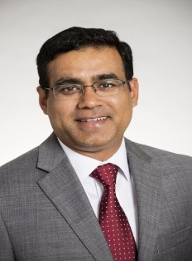
Faculty Assembly President Introduction
Manoj Pandey, PhD Associate Professor of
Biomedical Sciences

Slide 45
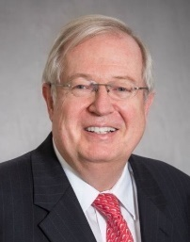
Acknowledgement
Roland Schwarting, MD Professor of Pathology
Faculty Assembly President
2022-2025

Slide 46
Thank You!

