Slide 1
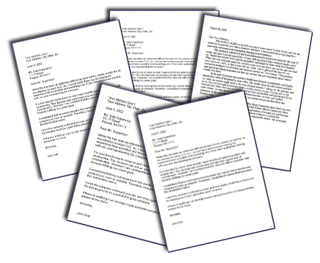
Writing Effective Letters of Recommendation of Trainees
Jennifer Kogan, MD
Ilene Rosen, MD
Barbara Wagner, MS

Slide 2
Objectives
1. Describe your responsibility when writing a LoR.
2. List essential features that should be present in a LoR.
3. Describe common mistakes to avoid when writing a
LoR.
4. Tailor a LoR based on performance level.

Slide 3
What types of letters of recommendation are you asked to write?

Slide 4
What are your greatest challenges writing letters of recommendation?

Slide 5
Fantasy Land of LoR
“ A wondrous place . . . Where people have
excellent interpersonal skills and about a tenth
of the inhabitants are among the finest I have
ever worked with, and almost all are in the
upper quarter.”
Friedman RB. Fantasy land. N Engl J Med. 1983;308:651-3

Slide 6
LoR Problems
Expectations not defined
No agreement on the adjectives
Inherent selection bias
Reliability and validity dubious
Shortened exposure to trainees

Slide 7
Objectives
1. Describe your responsibility when writing a LoR.
2. List essential features that should be present in a LoR.
3. Describe common mistakes to avoid when writing a
LoR.
4. Tailor a LoR based on performance level.

Slide 8
What is Your Responsibility
Trainee
Reader
Institution/Recruitment
Society/Profession
Yourself

Slide 9
Stakeholder | Responsibility
Trainee | Help advance as far as s/he can go
Reader | Provide useful data to select best/ appropriate candidate
Institution/ Recruitment | Help get learners to best places possible
Society/Profession | Gatekeeper to patient safety
Yourself | Honesty/integrity and your reputation

Slide 10
Writing the Letter
LoR
Constructive criticism NOT required/expected
Acceptable to include your subjective opinions more than you would in an evaluation
Evaluation letter or reference letter
Balanced letter expected

Slide 11
Getting Started
Commit enough time
Meet with the candidate
Review candidate’s CV/personal statement
Talk about their accomplishments
Know what they are applying for/career goals
Decide if it’s letter you feel comfortable writing
Read sample letters
Ask for feedback on your letters
Don’t ask learners to write their own letter

Slide 12
Objectives
1. Describe your responsibility when writing a LoR.
2. List essential features that should be present in a LoR.
3. Describe common mistakes to avoid
when writing a LoR.
4. Tailor a LoR based on performance level.

Slide 13
Three Important Components
Assessment of learner’s strengths
Based on first hand experience
Assessment of future performance
Applicant’s distinguishing features

Slide 14
Essential Features
Formal approach
Careful word selection
Honest/authentic
Specific, objective data
Information you would want to know
Relevant and germane skills/characteristics
Short and clear
Fair/in good faith
Larkin GL. Acad Emerg Med. 2001;8:70-3
Wright SM. JGIM. 2004;19:588-93

Slide 15
Format Instructions
Use official letter head
Address letter (e.g. “Dear XXX”)
Include student’s AAMC ID and ERAS letter ID
Ensure learner’s/candidate’s name spelled correctly throughout
1-1 1/2 pages
Sign letter (sign printed copy and scan or use electronic signature)
Save as PDF

Slide 16
Paragraph 1: Provide Context
Applicant’s name in first line
Purpose of the letter
Who are you?
How do you know the trainee?
In what capacity did you work together?
For how long?
What were key learner responsibilities?
Did trainee waive right to read letter?

Slide 17
Paragraph 1: Example
It is with utmost enthusiasm that I write
I have been asked to write this letter of recommendation
on behalf of Ima Star who is applying for an Internal Medicine
residency. I have been a rheumatologist for 15 years and
fellowship director for 5. I have worked with
Ima for two weeks during her Rheumatology elective during
her fourth year of medical school. During this elective,
Ima independently evaluated and presented two new
consults daily in addition to two follow-up presentations. She also
worked with me in the office on multiple occasions. As such, I feel
as though I am able to accurately comment on her capabilities.
Ima has waived her right to view this letter.
It is with great pleasure that I write

Slide 18
Paragraph 1: Example
I have been asked to write this letter of recommendation
on behalf of Ima Star. I have been a rheumatologist for
15 years and fellowship director for 5. I have worked with
Ima for two weeks during her Rheumatology elective during
her fourth year of medical school. During this elective,
Ima independently evaluated and presented two new
consults daily in addition to two follow-up presentations. She also
worked with me in the office on multiple occasions. As such, I feel
as though I am able to accurately comment on her capabilities.
Ima has waived her right to view this letter.

Slide 19
Family Educational Rights & Privacy Act (FERPA)
Federal law (1974) protects privacy of student education records
Applies to students at all schools receiving funds under an applicable program of the U.S. Department of Education
Gives students the right to consent to disclosure of any part of their “educational record” by the educational institution or one of its employees

Slide 20
FERPA and LoR
LoR are considered an education record if
faculty writes letter in role as faculty member
letter is about student’s tenure at school
Provides students with right to access LoR and complete applicant file

Slide 21
Waiving FERPA
Majority of schools/programs ask (some require) trainees to waive access to LoR
Once waived, trainee has no right to review LoR
Explicitly state in your letter trainee has made written waiver
No specific laws applicable for residents/fellows
BUT: most programs/employers prefer trainee waives right to review letter

Slide 22
Paragraph 2: Most Relevant Skills
Clinical letter
Medical Knowledge
Intellectual ability
Patient care skills
Analytic skills
Technical skills
Research letter
Skill formulating research question
Ability to select methodology
Data collection and interpretation skills
Scientific writing
Grant funding

Slide 23
Paragraph 3: Other Relevant Attributes
Interpersonal skills
Professionalism/Integrity
Character
Work ethic/attitude to learning/initiative
Sense of responsibility
Communication skills
Personality
Leadership skills

Slide 24
Remember
Be specific
Quantify and compare
Address requirements of the position
Personal attributes/special interests that make candidate unique
Beware of what you leave out

Slide 25
Use Impact Words
What words do you like
to see in a letter?

Slide 26
Use Impact Words
Efficient
Highly organized
Effective
Dedicated
Committed
Motivated
Intelligent
Team player
Collaborative
Confident
Self-assured
Empathic
Humanistic
Mature
Sincere
Enthusiastic
Shows initiative
Self- directed
Articulate
Observant
Leader
Integrity

Slide 27
Paragraph 4:Summary
Summarize overall findings
Repeat unique favorable attributes
Bottom line recommendation (quantify if can)
Overall fit for the position/institution/program
Offer for contact

Slide 28
Example
Compared to the other students I have worked with in
my 15 years as an attending on the consult service, Ima
is outstanding (top 10%). I wholeheartedly recommend
her to your residency program without any reservations.
Please do not hesitate to contact me if you desire
additional information.

Slide 29
Secret Language of Clinical Letters
Rank Words
Outstanding
Excellent
Very good
Good
Solid
Appropriate for level of training
Recommend
Wholeheartedly
Enthusiastically
Without reservation
With confidence
With pleasure
With comfort
Strongly
With reservation
Do not recommend

Slide 30
Don’t Forget to Edit!!!
Keep it to 1 to 1 ½ pages
Proofread and spell check
Especially pronouns (ask)
Re-read for gender bias

Slide 31
Gender Bias
Length
Emphasis
Women: strong work ethic/ training/ teaching
Men: research and ability
Adjectives
Men standout: superb, outstanding, remarkable
Women: minimal assurance
Gender stereotype: lovely, compassionate, nurturing
Trix and Psenka (2003)

Slide 32
Objectives
1. Describe your responsibility when writing a LoR.
2. List essential features that should be present in a LoR.
3. Describe common mistakes to avoid when writing a
LoR.
4. Tailor a LoR based on performance level.

Slide 33
Common Mistakes: Letters that Hurt

Slide 34
Common Mistakes: Letters that Hurt
List wrong specialty/position being applied for
Too short or too long
No specific examples
Gender bias
Reiterate information available elsewhere
Excessive focus on how the writer knows applicant without describing accomplishments

Slide 35
Common Mistakes: Letters that Hurt
Mention age, race/ethnicity, marital status, children, physical characteristics
Personal anecdote
Struggles

Slide 36
Objectives
1. Describe your responsibility when writing a LoR.
2. List essential features that should be present in a LoR.
3. Describe common mistakes to avoid when writing a
LoR.
4. Tailor a LoR based on performance level.

Slide 37
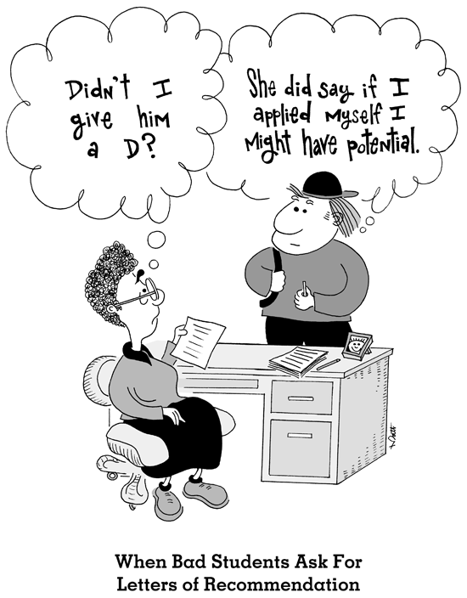
Troubleshooting the “Problem Letter”

Slide 38
Say No
Cannot write letter positive enough to be helpful
Have little/no recollection of applicant
NOTE: Can be remedied by
Keeping copy of all evaluations
Keeping copies of presentations
Face to face
Don’t have time

Slide 39
When You Can’t Write A Great Letter
Disclose beforehand
Limit criticism to one paragraph late in letter
Phrase criticism affirmatively

Slide 40
When You Can’t Write A Great Letter
Note impressive improvements/response to feedback
“ Over the course of his time with me, Justin developed more sophisticated differential diagnoses and plans for his patients.”
“It took a while for Justin to get his research projects started, but he now has an oral abstract and a poster presentation, and I think going forward he will make important contributions to the field.”
Focus on what was accomplished (EVEN if accomplishments were expected)
“Justin was punctual and always read about his patients.”

Slide 41
When You Can’t Write A Great Letter
Highlight previous successes
Repeat details from CV/academic record
Put interpersonal skills (3rd paragraph) as 2nd paragraph for more academically weak candidates

Slide 42
Examples
“Her teaching will improve once she gains a higher level of confidence….”
“His fund of knowledge will improve as he continues to read about his patients….”
“I’m confident that her interpersonal skills will improve as she gains more experience working on a team….”
“He readily accepts and incorporates feedback regarding his need to work on….”

Slide 43
Legal Perspectives
Don’t disclose information without written permission
Ask trainee to waive right to access
Only share factual, truthful statements made in good faith
Never disclose private (i.e. medical) information
Review negative comments to make sure they are accurate and factual

Slide 44
Top 10 List for Effective Letters
Authentic: based on 1st hand knowledge
Honest: accurate; avoid exaggeration or hyperbole
Relevant: describe important skills/attributes
Specific: provides examples to support praise
5. Confidential: avoid unnecessary disclosure
Appropriate detail /length
Technically clear: avoid unnecessary jargon
8. Use the right code words
9. Personalized: Tailor comments for the applicant
10. PROOFREAD, PROOFREAD, PROOFREAD!!

Slide 45
Questions

Slide 46
Practice
Ima Star
Justin Soso
Read each LOR
Use worksheet to list LOR strengths/flaws
Revise LOR

