Slide 1
Faculty Assembly Annual Meeting
September 17, 2024
Welcome faculty, colleagues and friends of CMSRU and CUH

Slide 2
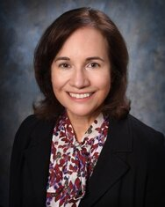
State of the Medical School
Annette C. Reboli, M.D.
Dean
Professor of Medicine
Tenured Professor of
Biomedical Sciences

Slide 3
Faculty Assembly Update
Roland Schwarting, M.D.
Faculty Assembly President
Professor of Pathology

Slide 4
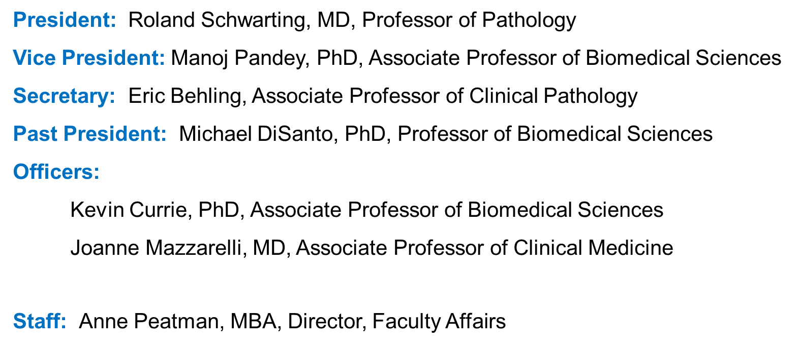
Faculty Assembly Executive Members

Slide 5
Admissions Committee
Gary E. Stahl, MD, Committee Chair
2023-2024 Highlights of Committee Work
Selection Class of 2028 students
  (4660 applications received)
18 committee meetings & 16 interview days
  (354 candidates interviewed)
2 open houses for accepted students (Dec & Mar)
CMSRU Class of 2028 metrics:
  Class size – 113
  71% of accepted students from NJ
  Average overall GPA – 3.86
  Average science GPA – 3.82
  Average MCAT – 512 (83%ile)

Slide 6
Admissions Committee
2024-2025 Future Goals and Plans
The primary goal of the committee continues to be recruitment of a diverse population of students who have demonstrated academic readiness for medical school, as well as a match to the CMSRU mission.
The admissions process will continue to utilize a holistic approach when considering candidates.

Slide 7
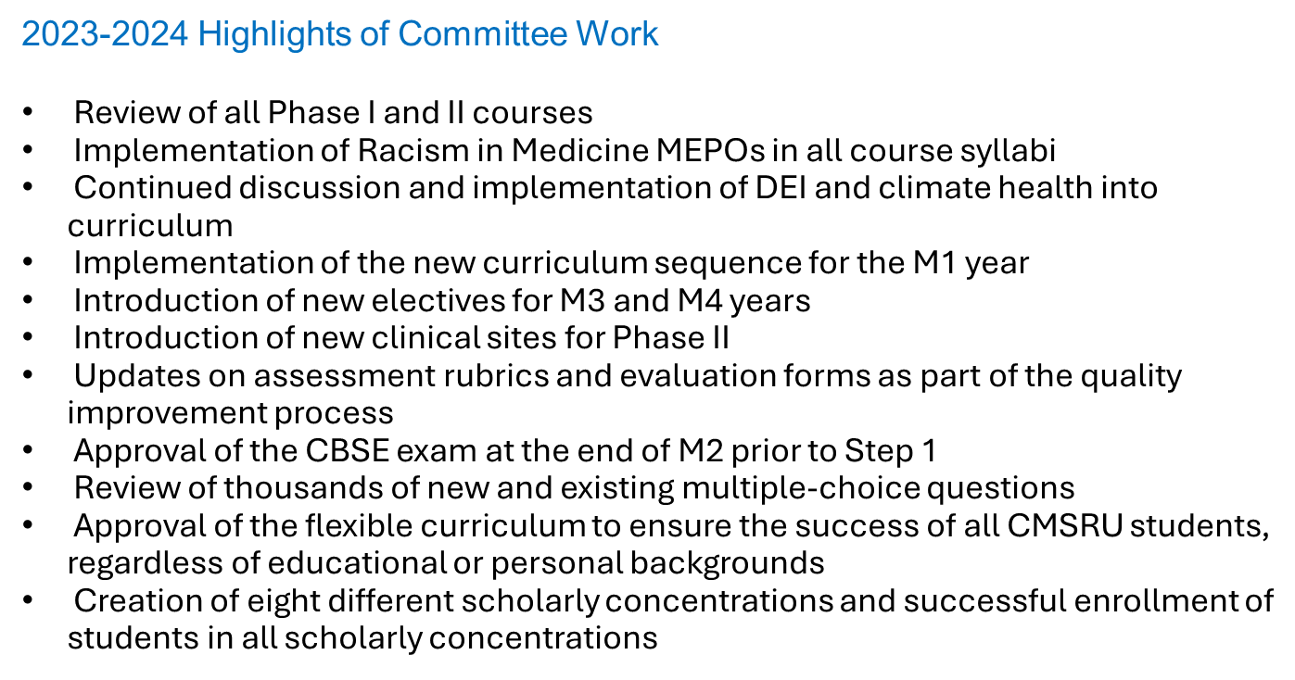
Curriculum Committee
Ritesh Patel, MD, Committee Chair

Slide 8
Curriculum Committee
2024-2025 Future Goals and Plans
Implement a new curriculum sequence for the M-2 year
Review the current exam review process to identify areas for improvement
and efficiency
Encourage course directors to develop new ALG cases to expand the
repertoire.
Continuously evaluate the curriculum to add flexibility that enhances
student success
Expand the diversity and scale of scholarly concentrations available to
students
Conduct faculty development sessions to enhance the skills and
preparedness of CMSRU faculty

Slide 9
Academic Standing Committee
Sandy Nairn, MD, Committee Chair
2023-2024 Highlights of Committee Work
Raising of the classes
Decisions regarding Academic and Non-academic probation
Recommending candidates for CMSRU class of 2024 graduation to the Departmental Chairs
Professionalism reviews
Dismissal reviews
Reviews for extension for Step1 exam
Approving changes to the GPA policy

Slide 10
Advisory Committee on Appointments & Promotions
John Baxter, MD, Committee Chair
2023-2024 Highlights of Committee Work
A&P Committee processed and reviewed:
  177 new faculty appointments (full time, clinical instructor, volunteer)
23 faculty promotions
  297 clinical faculty and volunteer reappointments
A&P Policy Changes
- CMSRU Faculty Pathways and Specific Rank Criteria
(Academic, SPT, Non-Tenure Track Teaching Professors and Affiliate)
- Update Criteria to promotion on Scholarship of Practice and Teaching
(SPT) Pathway with identified area of expertise

Slide 11
 | Faculty Promotions
Assistant Professors (3) | Lioudmila Lipetskaia, MD, Associate Professor of Obstetrics and Gynecology | Professors (5)
Ian Gleaner, MD, Assistant Professor of Medicine | Jack Shilling, MD, Associate Professor of Clinical Orthopaedic Surgery | Steven Kaufman, MD, Professor of Clinical Medicine
Heather Fellmeth, PsyD, Assistant Professor of Clinical Psychiatry | Eric Behling, MD, Associate Professor of Clinical Pathology | Elizabeth Leilani Lee, MD, Professor of Clinical Medicine
Christina Orate-Dimapilis, MD, Assistant Professor of Clinical Medicine | Dejan Nikolic, MD, Associate Professor of Pathology | Faith Young, MD, Professor of Clinical Medicine
Associate Professors (15) | Mohammed Hussain, MD, Associate Professor of Clinical Pediatrics | Pauline Germaine, DO, Professor of Radiology
Christopher Potestio, MD, Associate Professor of Anesthesiology | Robyn Roth, MD, Associate Professor of Clinical Radiology | Steven McClane, MD, Professor of Clinical Surgery
Joanne Mazzarelli, MD, Associate Professor of Clinical Medicine | Megan Mezera, MD, Associate Professor of Clinical Radiation Oncology
Swarna Rajagopalan, MD, Associate Professor of Neurology | Anna Goldenberg- Sandau, DO, Associate Professor of Surgery
Michelle Iavicoli, MD, Associate Professor of Clinical Obstetrics and Gynecology | Ronak Gor, DO, Associate Professor of Surgery
Alisa Modena, MD, Associate Professor of Clinical Obstetrics and Gynecology | Young Ki Hong, MD, MPH, Associate Professor of Surgery

Slide 12
Nominations & Elections Committee
Michael Sabia, MD, Committee Chair
2023-2024 Highlights of Committee Work
Maintained a full compliment of diverse members and specialties on all CMSRU committees.
For the upcoming 2024-25 academic year, 17 elected and 10 appointed standing committee positions were vacant.
All positions filled in election or by Dean’s appointment
CMSRU Bylaws Updates
The Curriculum Committee, Advisory Committee on Appointments and Promotions and
Admissions Committee are considered time intensive committees, faculty may not serve on
more than one of these 3 committees at any given time.
After completion of a full 6 years on a specific committee, the faculty member must step off the
committee for at least 2 years prior to serving again on that committee.

Slide 13
 | Elected Committee Members
 | Academic Standing Committee Adam Green, MD, MBA, Associate Professor of Medicine Admissions Committee Bethany Canver, MD, Assistant Professor of Medicine Erica Chirco, PhD, Instructor of Biomedical Sciences Navjot Jain, DO, Assistant Professor of Medicine Maureen Moore, MD, Assistant Professor of Surgery Advisory Committee on Appointments and Promotions Anthony Infantolino, MD, Professor of Medicine Committee on Diversity and the Learning Environment Carlo Foppiano-Palacios, MD, Assistant Professor of Medicine Hamza Shaikh, MD, Assistant Professor of Neurological Surgery Curriculum Committee Andrea Bottaro, PhD, Professor of Biomedical Sciences Gabriella Contino, MD, Assistant Professor of Medicine Natali Franzblau, MD, Associate Professor of Clinical Obstetrics & Gynecology Faculty Development Committee Anu Mookerjee, MD, Professor of Clinical Medicine Mina Ramchand, MD, Assistant Professor of Radiology Rule of Procedure Committee John Safaryn, MD, Associate Professor of Clinical Anesthesiology
Notes:
12

Slide 14
 | Appointed Committee Members
 | Academic Standing Committee Ed Dedkov, MD, PhD, Associate Professor of Biomedical Sciences Christina Tofani, MD, Associate Professor of Medicine Admissions Committee Ronald Miick, MD, Associate Professor of Pathology Committee on Diversity and the Learning Environment Kyle Gleaves, MD, Assistant Professor of Medicine Committee For a Positive Learning Environment Yon Sook Kim, MD, Assistant Professor of Obstetrics & Gynecology Conflict of Interest Committee Susy Kohout, PhD, Associate Professor of Biomedical Sciences Frances Martinez-Diaz, MD, Assistant Professor of Obstetrics & Gynecology Curriculum Committee Camille Henry, MD, Assistant Professor of Family Medicine Faculty Development Committee Amanda Fakira, PhD, Assistant Professor of Biomedical Sciences Library and Informatics Committee Tyler McMillan, MD, Assistant Professor of Clinical Medicine
Notes:
13

Slide 15
Faculty Development Committee
Cheryl A. Melovitz-Vasan, PT, DPT, PhD
2023-2024 Highlights of Committee Work
CME programming via Medical Education Grand Rounds, Faculty Development Forums, BMS research seminars
Highly Successfully Faculty Development Week (March 4-6)
Workshops and presentations included AI in Education, using Podcasts, social media, blogs
in education, lo-fi simulation, feedback workshop, resident remediation, coaching medical
students…
Rowan Marketplace CMSRU Enduring Materials modules
2024-2025 Future Goals and Plans
Faculty Development Day - March 5, 2025
New Research Development Series for Faculty and Trainees

Slide 16
Research Committee
Christopher Jones, MD, Committee Chair
2023-2024 Highlights of Committee Work
Dr. Darren Boehning newly appointed Associate Dean for Research
Capstone Speed Dating event in September 2023 gave more than 100 students opportunity to speak with over 30 representatives from numerous departments to identify Capstone Project mentors
Camden Scholar’s Forum in April 2024 provided students and trainees from CMSRU/Cooper the opportunity to showcase research activities. Forum featured 245 submissions from medical students, residents, fellows and nurses.
2024-2025 Future Goals and Plans
Develop a plan for utilization and allotment of research space.
Capstone Speed Dating scheduled:
Tuesday, September 24th at 5:30 pm in CMSRU MPR

Slide 17









CMSRU Active External Grant Awards – BMS Faculty 2023-2024
Over 6 million in new funding this year and over double the number of awards

Slide 18
CMSRU Active Grant Awards – Non-BMS Faculty
2023-2024

Slide 19
CUHC Grant Revenue 2023-2024 Academic Year
Department | Education | Research | Service | Total Receipts
Anesthesiology | $0.00 | $118,562.00 | $0.00 | $118,562.00
Emergency Medicine | $0.00 | $401,464.23 | $897,864.22 | $1,299,328.45
Medicine | $0.00 | $782,572.32 | $11,923,446.34 | $12,002,018.98
Neurology | $0.00 | $15,830.00 | $40,000.00 | $55,830.00
Neurosurgery | $0.00 | $72,932.93 | $0.00 | $72,932.93
Ob Gyn | $35,242.00 | $406,089.39 | $0.00 | $441,331.39
Orthopaedics | $5,000.00 | $8,000.00 | $0.00 | $13,000.00
Pediatrics | $0.00 | $89,187.70 | $676,764.00 | $765,951.70
PM&R | $2,500.00 | $10,640.00 | $0.00 | $13,140.00
Psychiatry | $365,933.37 | $0.00 | $3,648,667.96 | $4,014,601.33
Radiology | $0.00 | $144,007.50 | $0.00 | $144,007.50
Surgery | $0.00 | $781,483.39 | $0.00 | $781,483.39
TOTAL | $408,675.37 | $2,830,769.46 | $16,891,418.21 | $19,722,187.67

Slide 20
Diversity and the Learning Environment
Fay Young, MD, Committee Chair
2023-2024 Highlights of Committee Work
  The Committee emphasizes the importance of outlining the expectations of understanding and supporting diversity, equity and inclusion during all interactions with colleagues, learners, and patients at CMSRU/CUHC. The Office of Diversity and Community Affairs is headlining these initiatives during orientation and on-boarding of new faculty.
  The Committee supports providing meaningful resources & programmatic investment in D/E/I leadership and opportunities for growth within CMSRU and CUHC units, divisions, and departments.
  The Committee supports implementation of the formal recommendations of the Office of Medical Education’s Ad Hoc subcommittee on Racism in Medicine.
2024-2025 Future Goals & Plans
  Civil discourse skills can empower everyone in the learning environment and are a critical component of an environment that contributes to and supports inclusion and belonging. Develop and recommend appropriate opportunities to teach and enhance these skills.

Slide 21
Positive Learning Environment Committee
Kristina Williams, MD, Committee Chair
2023-2024 Highlights of Committee Work
CUH Community education – ”Cultivating a positive learning environment”: 15 min educational talks given to faculty in following departments: Department of General Surgery Faculty; Cooper Heart Institute Faculty & Fellows; Heme/Onc Faculty; Emergency Medicine Faculty; Anesthesia; OBGYN; Radiology; Pediatrics.
Distribution of Tip Sheet for Positive Learning Environment to CUH Faculty.
Monitoring of learning environment with mistreatment survey. Anonymous survey of trainees (residents and students) which asks about mistreatment in the learning environment. Survey distributed at 6-month intervals. Initial data presented during PLEC meetings.
Review of learning environment reports. Identified the OR/nursing staff as a source of areas of weakness in the learning environment.
Notes:
20

Slide 22
Positive Learning Environment Committee
2024-2025 Future Goals and Plans
Continue community education
Create resident education requirement
Create education for OR/RN staff
Plan for ongoing education and circulation of “tip sheet”
Continue review of learning environment
Notes:
21

Slide 23
Library Informatics Committee
Meena Khandelwal, MD, Committee Chair
2023-2024 Highlights of Committee Work
Dean Reboli charged the committee and asked that a Task Force be formed to develop recommendations for AI in Medical Education both undergraduate and graduate.
  - Committee had several brainstorming discussions in advance of asking for volunteers for the AI Task Force
  - A Google drive was created and populated with informational materials that included: contributions from each
  committee member, examples of student & resident use of AI, key articles, AI policies from other institutions, and
  slides from an AI presentation by a committee member
  - AI Recommendation shared with the wider committee and voted on during joint meeting of committee & task force
  in April before sharing with Dean Reboli
Committee reviewed the Rowan University Libraries support for Open Access Publishing and how to best promote the Read & Publish/Transformative Agreements
Committee reviewed original plan for the new Library/Learner Hub in Tower A, the first building in the Cooper Project Dream Expansion [new plan with many changes has since been proposed, May 2024]
Committee members were invited to a visit from the CEO from the British Publishing Group (BMJ), UK, in March to share a Data Storytelling Session of Cooper/CMSRU impact on the wider community, share a roadmap for BMJ Best Practice, and to talk about the new Read & Publish agreement with Rowan University.

Slide 24
Conflict of Interest Committee
Michael Goodman, MD, Committee Chair
2023-2024 Highlights of Committee Work
Enhance COI education at the UME, GME, and CME levels.
2024-2025 Future Goals and Plans
Continued training of students, residents, and faculty on recognizing COI, since CMSRU policies on COI cannot be enforced in non-CMSRU sites.

Slide 25
Continuous Quality Improvement Committee
Ami Joshi, DO, MBA, Committee Chair
2023-2024 Highlights of Committee Work
New Standing Committee - held first meeting on May 17, 2024.
Committee was charged by the Dean and reviewed its
responsibilities.
2024-2025 Future Goals and Plans
Begin monitoring and evaluating CMSRU programs
Ensure committee work and processes are efficient, feasible and useful

Slide 26
Rules of Procedure
Manoj Pandey, PhD, Committee Chair
2023-2024 Highlights of Committee Work
Committee reviews and approves requested changes to CMSRU Bylaws.
Most significant change was removal of Hearing Body for Student Rights Committee. An Ad Hoc committee will be formed if/when necessary.
Section XIII Committees – language added regarding time intensive committees and rotation off committee and return to same committee.

Slide 27
Special Acknowledgements
Annette Reboli, MD, Dean, CMSRU
Ali Houshmand, PhD, President, Rowan University
Tony Lowman, PhD, Provost, Rowan University
Anthony Mazzarelli, MD, JD, MBE, Co-President/CEO, CUHC
Kevin O’Dowd, JD, Co-President/CEO, CUHC
Anne Peatman, MBA, Director, Faculty Affairs

Slide 28
Thank You!

